Slide 1
Project 2
Jessica Hills
Rebecca Mih

Slide 2
Project requirements
Your project should fall into one of the below four tracks:
A custom "creative" D3.js project (i.e. non-standard graph or chart)
A combination of Web Scraping and Leaflet or Plotly
A dashboard page with multiple charts all updating from the same data
A "thick" server that performs multiple manipulations on data in a database prior to visualization (must be approved)
Your project should include at least one JS library that we did not cover. – Possibly Chart.js
Your project must be powered by a dataset with at least 100 records.
Your project must include some level of user-driven interaction (e.g. menus, dropdowns, textboxes, etc.)
Your final visualization should ideally include at least three views

Slide 3
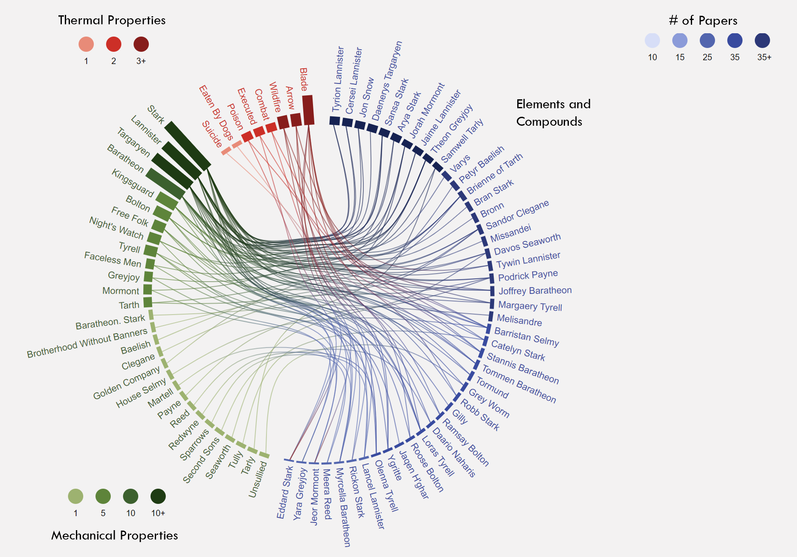
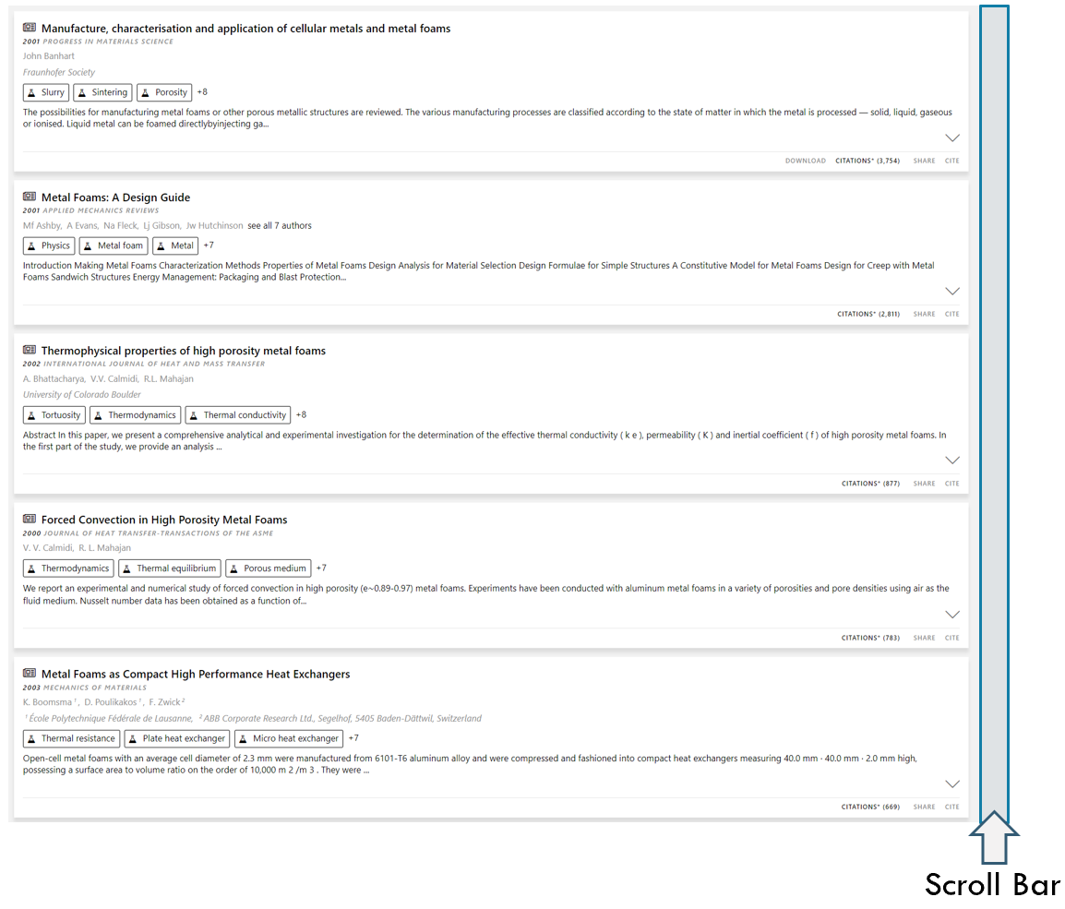
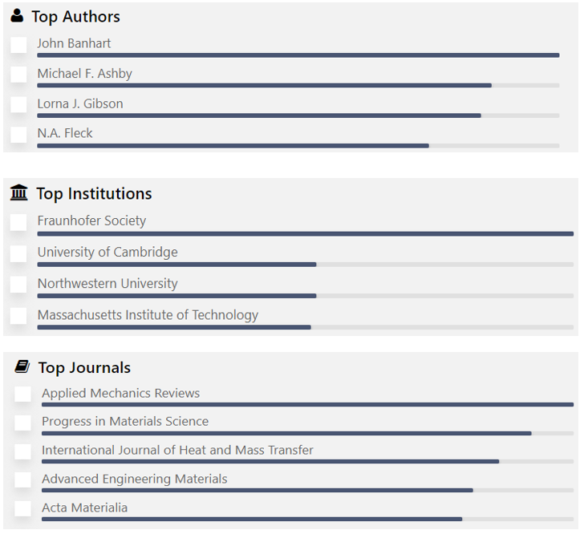
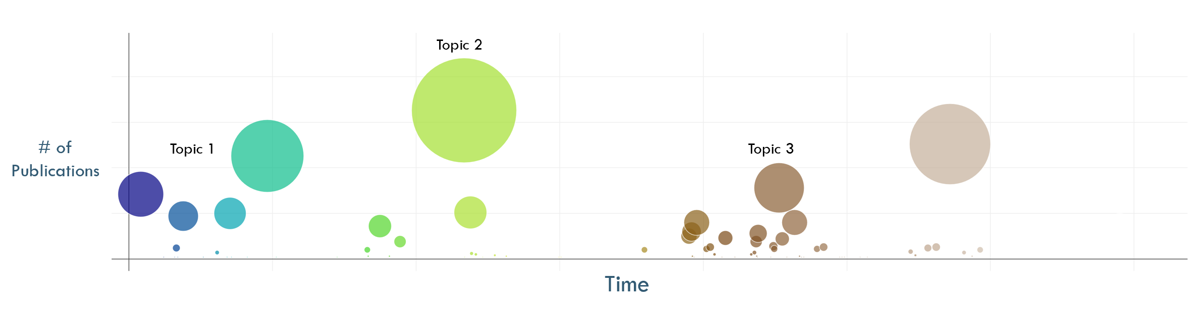
Sample Research Notebook
Search Results and Popularity
Select topics
◻ Topic 1
◻ Topic 2
◻ Topic 3

Slide 4
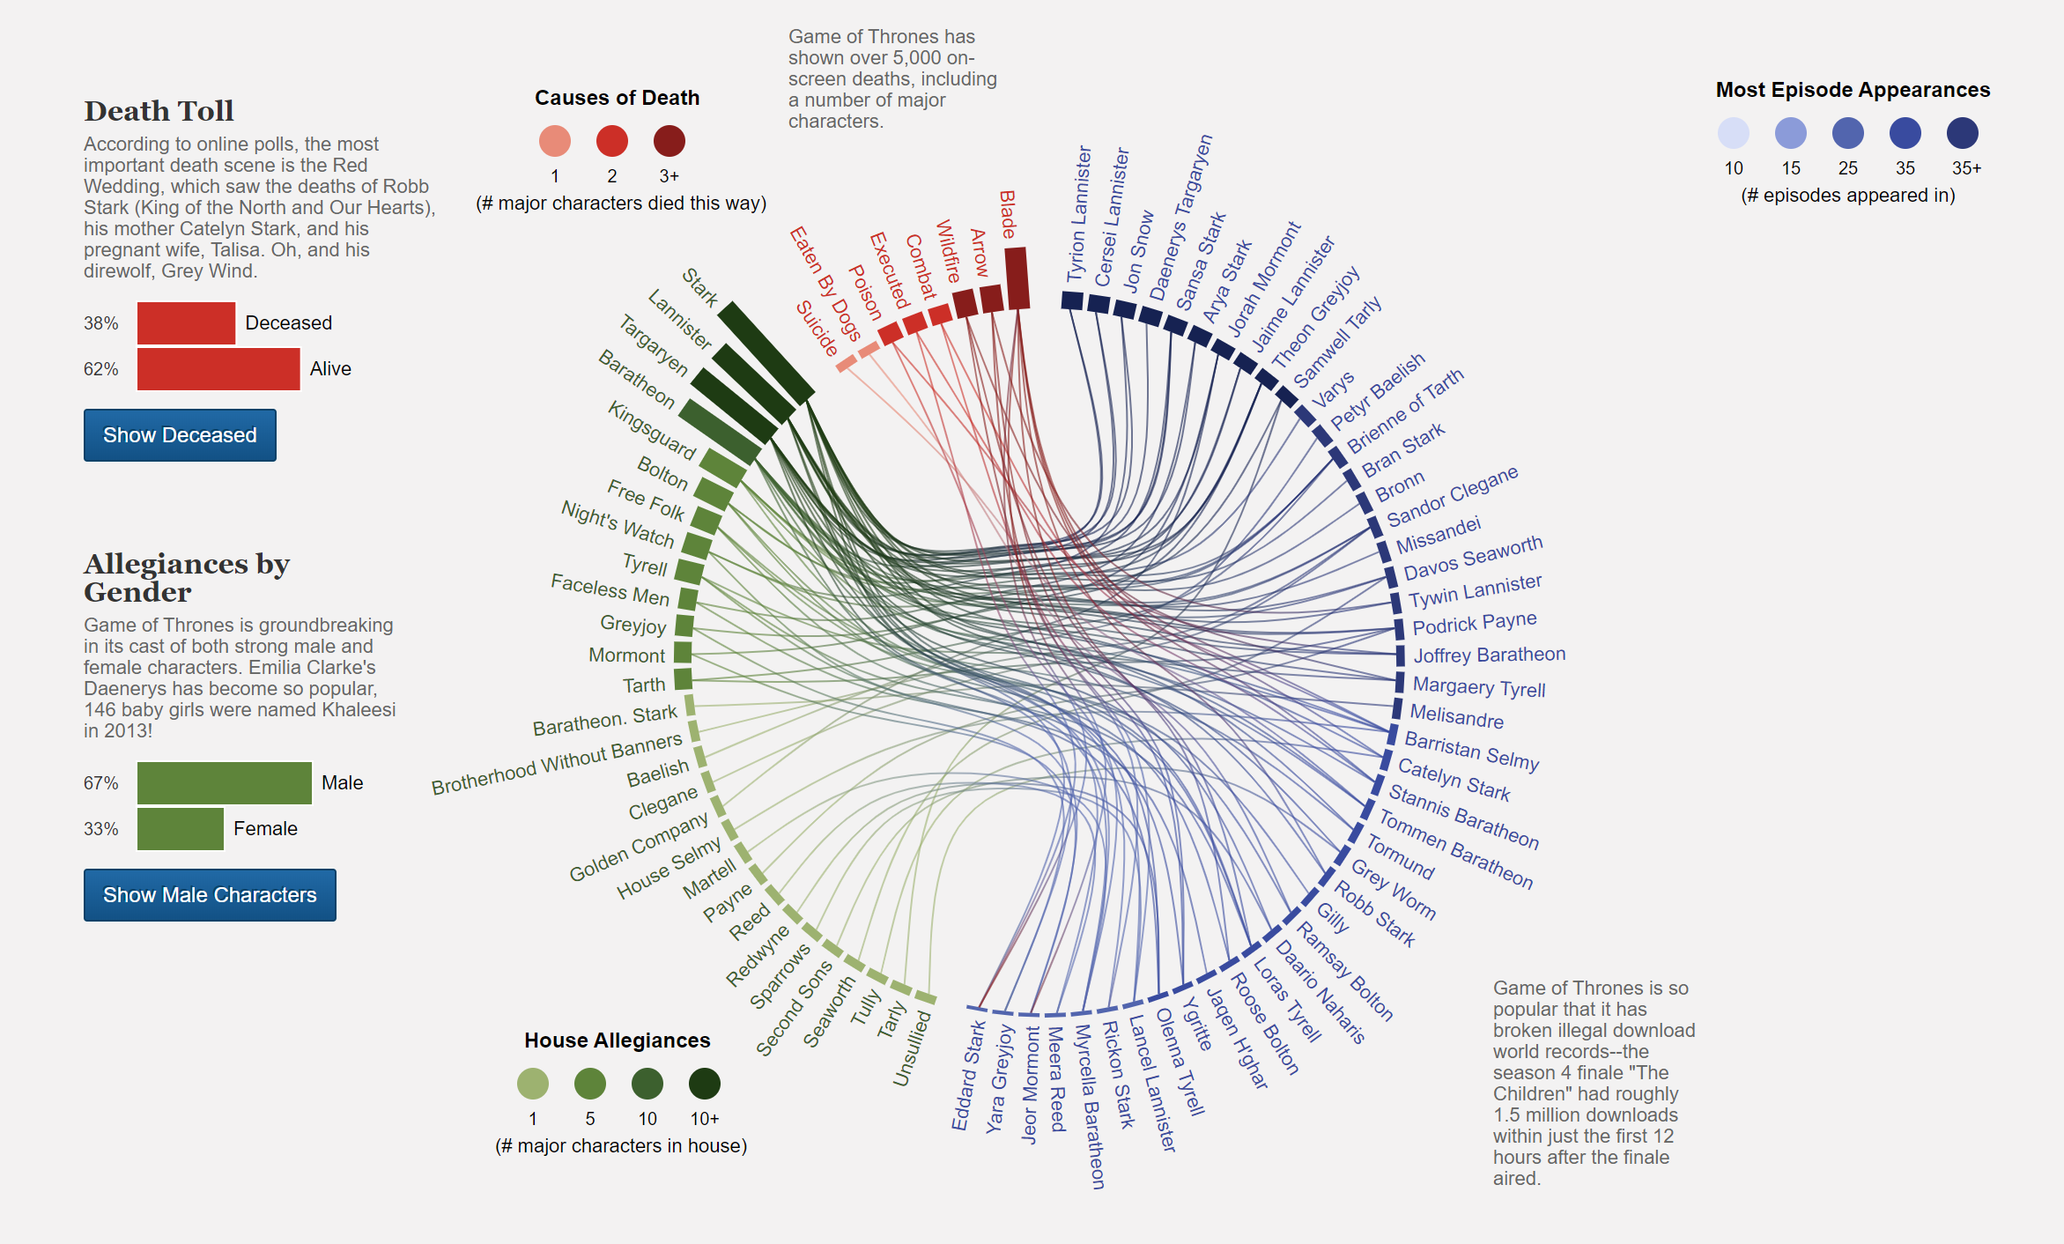
Properties analysis
Thermal Properties
# of Papers
Elements and Compounds, Alloys or composites
Mechanical Properties

Slide 5
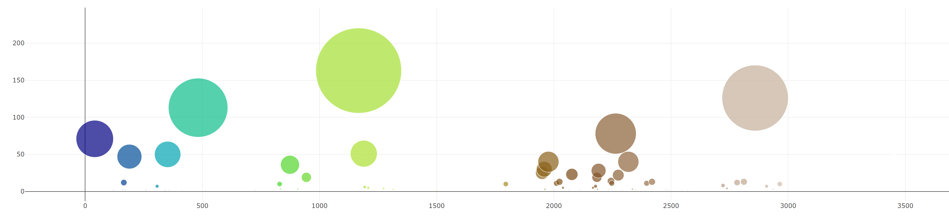
Publication timeline
Topic 2
# of Publications
Topic 1
Topic 3
Time
Could also be a bar chart?
Different colors = different compounds or elements?

Slide 6
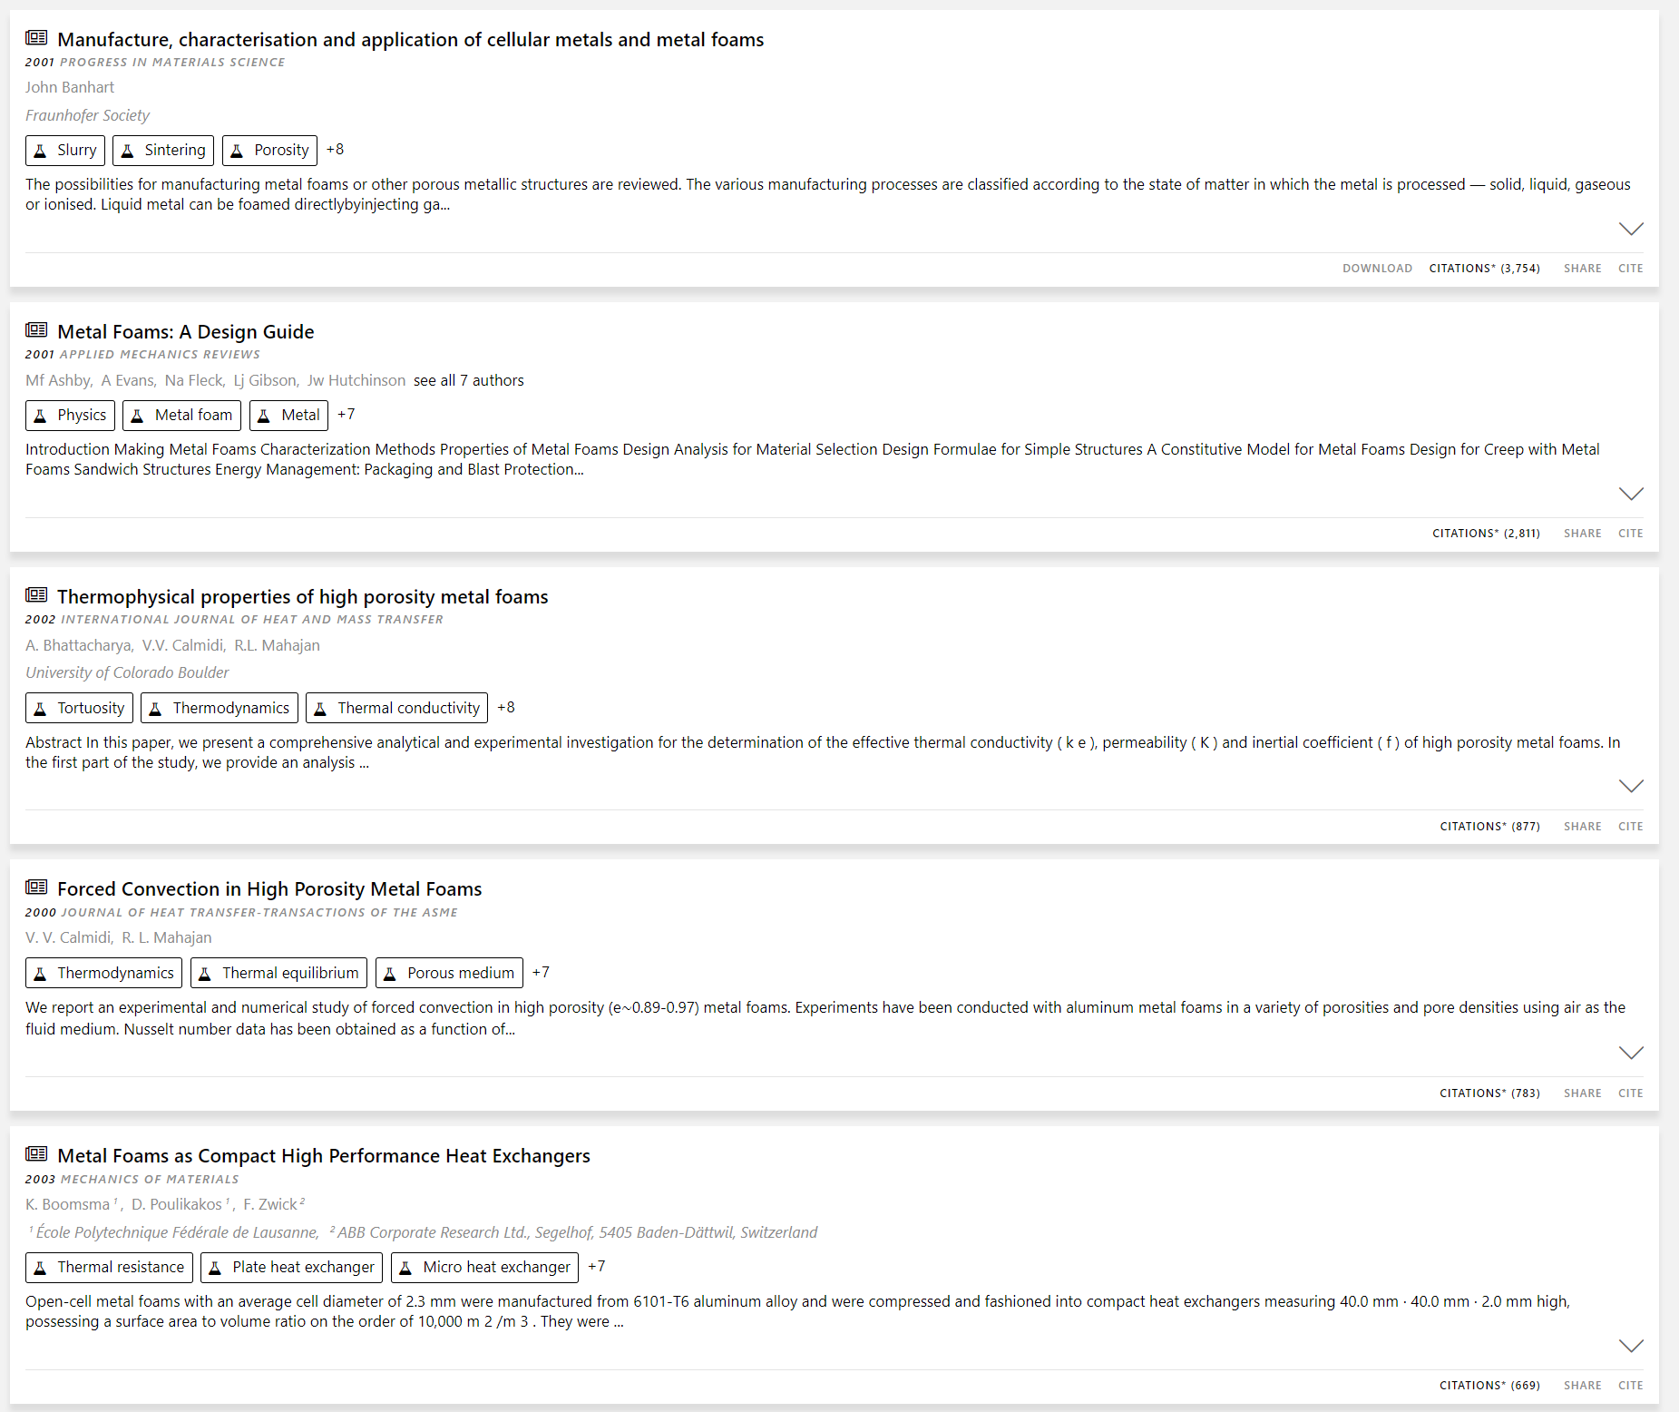
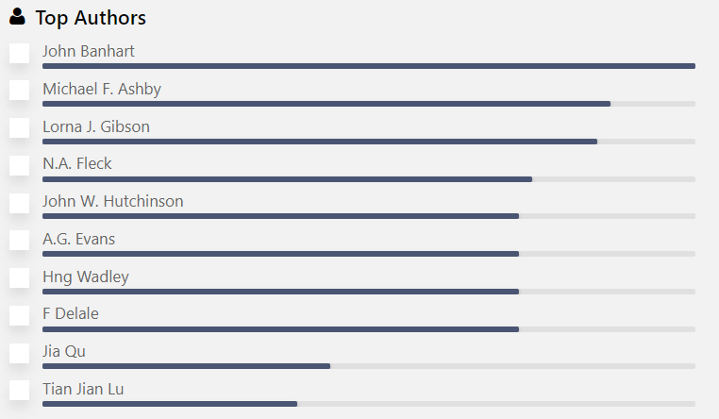
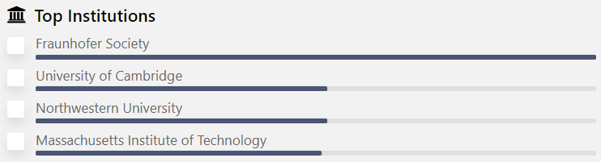
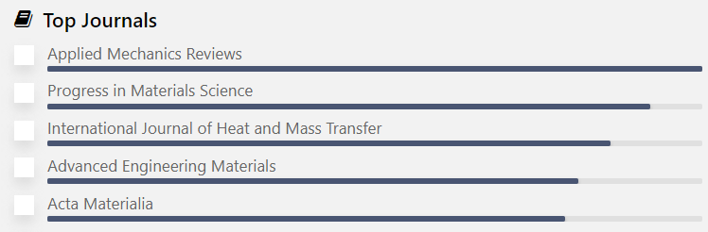
Results Table
Sorting Options
◻ Newest
◻ Oldest
◻ Most Citations
Filters
Scroll Bar

